Slide 1
Project Report - Business Problem Analysis for identifying neighborhood for Indian restaurant
- Shivaprasad

Slide 2
Business Problem
To identify an ideal neighborhood for Indian restaurant.
To reduce competition for new business thus increasing potential profits.
Identify the existing businesses in the same field.

Slide 3
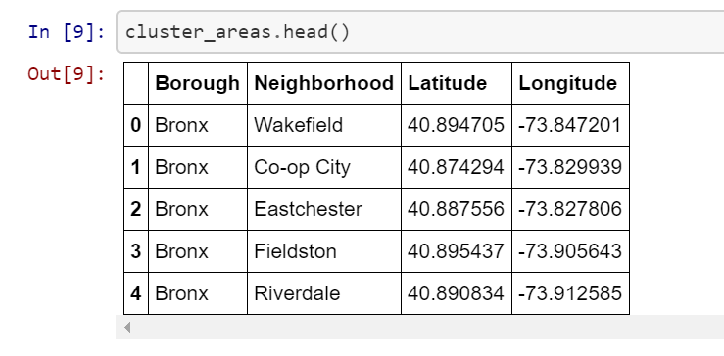
Cluster Areas:

Slide 4
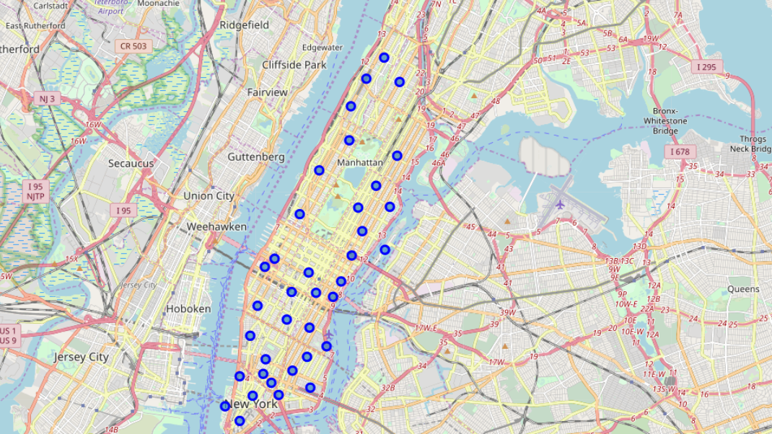
Foursquare API to explore neighborhoods in Manhattan, New York

Slide 5
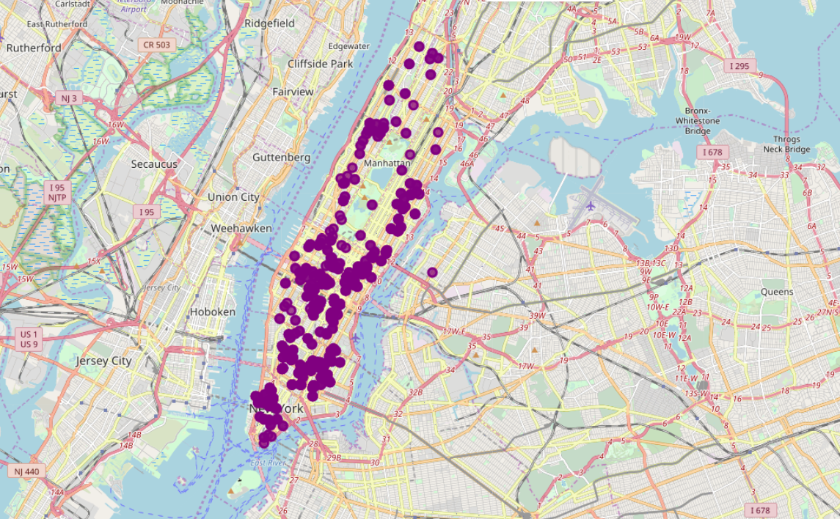
Indian restaurants in various neighborhoods

Slide 6
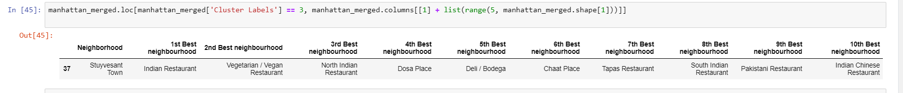
The neighborhood which is good for Indian Restaurant business

Slide 7
Thank you

